Slide 2
Sustainable methods of cleaning: which washing product?

Slide 3
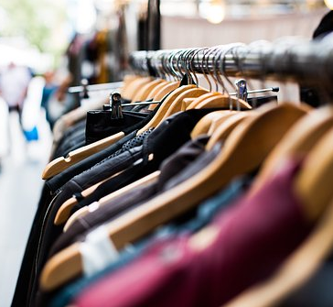
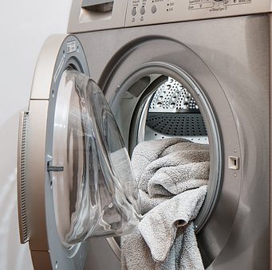
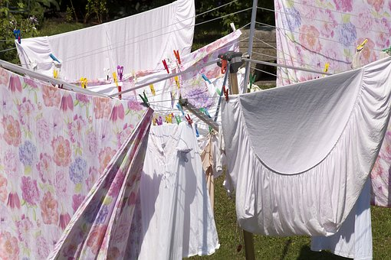
Did you know . . . ?
It is estimated that 97% of UK households today own a washing machine!
UK households carry out an average of 244 wash cycles
a year!
Carry out some research of your own.

Slide 4
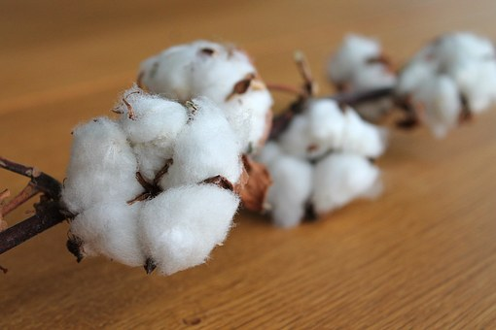
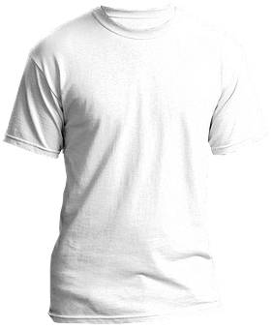
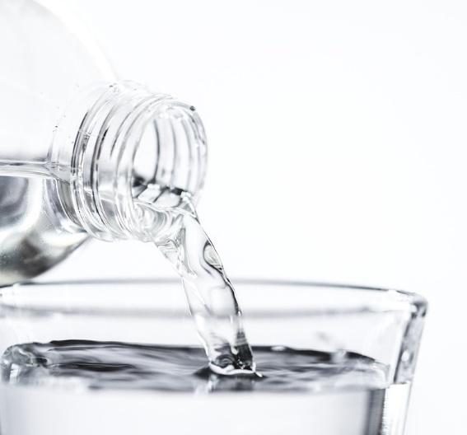
Our clothes are made from lots of different types of material called fabric.
Cotton is a natural material, grown with the seeds of the cotton plant, and is used to make clothing such as T-shirts and jackets.
Cotton needs a lot of water - up to 2700 litres to grow enough for just one T-shirt!
That’s enough for one person to drink for
two and a half years!
Notes:
Children will be interested to learn that across the United Nations, agencies are working to make fashion more sustainable. Some innovative examples of this include:
- Spain’s Ecoalf collects ocean plastics from 33 ports and turns the trash into shoes, clothing and bags as part of its Upcycling the Oceans collection.
- In Amsterdam, GumDrop collects used chewing-gum from paths and turns it into a new kind of rubber which is then used to make shoes. It takes around 2.2 pounds of gum to make four pairs of trainers.
- Outdoor gear retailer Patagonia, based in California, has been producing fleece jackets using polyester from recycled bottles since 1993 and mends and recycles older items.
- Gothenburg-based Nudie Jeans uses organic cotton for its jeans and offers free repairs for life. Customers also get a discount if they hand in their old jeans.
- Cambodia-based Tonlé uses surplus fabric from mass clothing manufacturers to create zero-waste fashion collections. It uses more than 97 per cent of the material it receives and turns the rest into paper.
In the Netherlands, Wintervacht turns blankets and curtains into coats and jackets.
San Francisco- and Bali-based Indosole turns discarded tyres in Indonesia into shoes, sandals and flip-flops, while Swiss firm Freitag upcycles tarpaulins, seat belts and bicycle inner tubes to make their bags and backpacks.
- Retailer H&M has a successful garment collection scheme. Customers who bring in five or more items of clothing or shoes, will receive discounts. Wearable items will be recycled as second-hand goods, while unwearable items will be turned into new products.

Slide 5
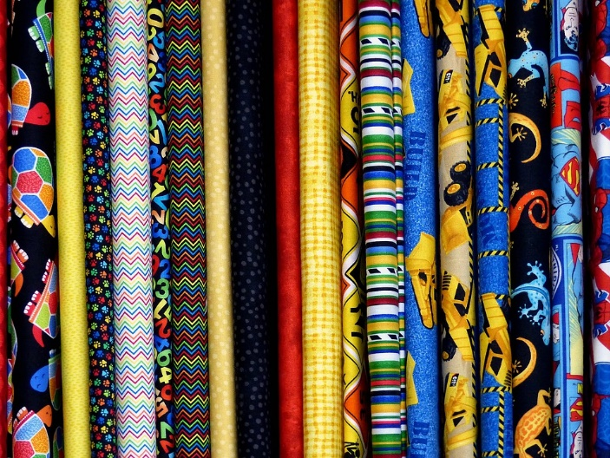
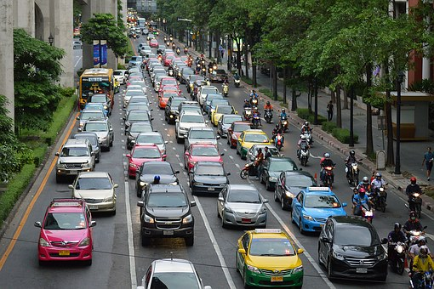
When fibres of material are grown, spun, weaved,
dyed and made into items of clothing, this produces carbon dioxide as energy waste.
Reports show that the fashion industry generates 1.26 billion tons of carbon dioxide
every year. This is the same as 372 million cars driving for one year!
Notes:
There are some staggering statistics to be looked into further if children are interested in carrying out their own research into the environmental impact of ‘fast fashion’.
Investigator
Stacey Dooley is a journalist and documentary film maker. In 2018, she made the documentary Fashion’s Dirty Secrets, which explores the shocking impact our insatiable appetite for cheap clothing is having around the globe and recent claims that the fashion industry is one of the top five most-polluting industries in the world, alongside the oil industry.

Slide 6
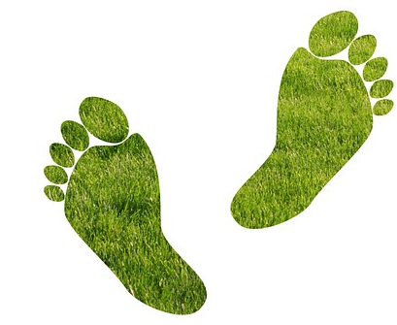
Every time we use a fuel, like coal, gas or oil, we create carbon dioxide gas as waste.
The total amount of carbon dioxide gas that you produce is called your carbon footprint.
A big carbon footprint is bad for the planet.
What can you do to reduce your carbon footprint?
Notes:
Recent reports have shown that in order to hold the global temperature rise to 2˚C or less, everyone on earth will need to average an annual carbon footprint of 1.87 tons by 2050. Currently, the average U.S. per capita carbon footprint is 18.3 tons. By comparison, China’s per capita carbon emissions are 8.2 tons. Discuss how many of us have a long way to go to get to 1.87 tons. Children will be interested to calculate their own and family members’ carbon footprint at websites such as https://footprint.wwf.org.uk/#/
Please note: This activity links closely to Activity 1 when children complete a survey and think about ways in which they can help to look after the Earth for future generations.
Suggestions from children might include:
Eat fruit, vegetables, grains and beans
Choose organic and local foods
Compost food waste
Keep and wear items of clothing for longer periods of time
Wash clothes at cooler temperatures
Buy and use recycled items wherever possible
Bring your own reusable bag when you shop
Try to buy and use products with less packaging
Switch lights off and unplug electronic devices when not in use
Walk, take public transport, car share or cycle to your destination whenever possible.

Slide 7
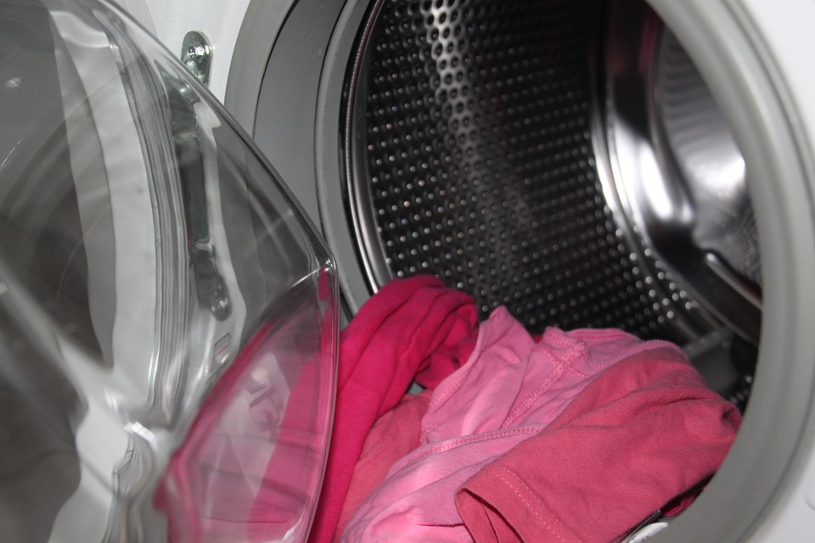
PMI: Using an automatic washing machine to wash your clothes . . .
Positive
Minus
Interesting
Notes:
The PMI is a discussion and thinking tool which allows children to consider all sides and opinions involved in a balanced argument.
Ask children to think first for themselves and then pair up to discuss the positives and negatives and anything else that fits into the ‘interesting’ category (neither positive or negative but interesting nonetheless).
Discuss children’s ideas - how modern washing machines and washing products are quick and efficient at removing stains from clothing compared to old fashioned methods of soaking, beating, scrubbing and rinsing by hand. However, we must also consider if current methods are sustainable and ask ourselves what damage we could be causing our environment. Encourage children to share any negative aspects to modern washing methods, such as how modern washing machines use excessive amounts of water - depending on the type of washing machine, up to 40 gallons of water may be used per load of laundry! Discuss how washing machines are among the largest consumers of energy in a typical modern home due to the electricity required to heat the water and drive the motors and that this is adding to our carbon footprint.

Slide 8
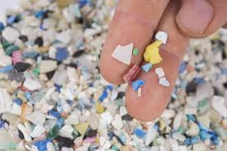
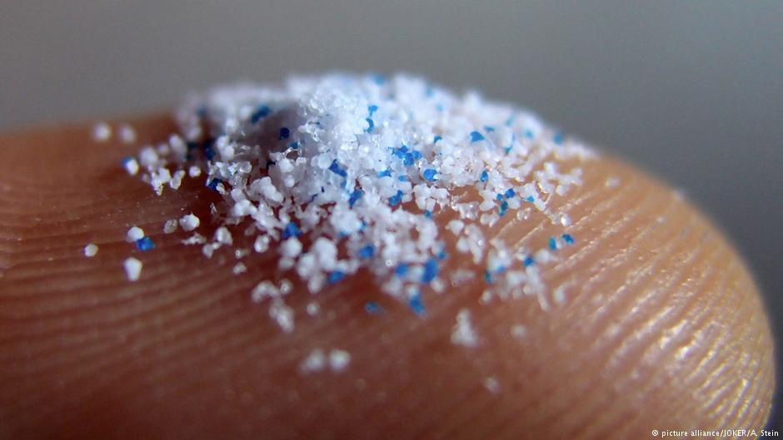
What are microplastics?
Microplastic fibres come from clothing, such as leggings, fleeces and jumpers made from nylon, polyester and acrylic. During washing, the fibres are released into the water and can end up in our oceans.
You can find out more about microplastics, also known as nurdles, at
https://www.nurdlehunt.org.uk
If you live near, or are visiting the seaside, you can join the Great Nurdle Hunt,
and upload your findings.
Notes:
This slide can be included as a continuation of negative aspects to modern washing methods. Discuss another important environmental issue with children that every time you run your washing machine, you may be releasing over 700,000 microscopic plastic fibres (less than 5mm in size) into the environment. These come from synthetic clothing, such as leggings, fleeces and jumpers made from nylon, polyester and acrylic, that release the fibres into the water when washed and can end up in our oceans. These microplastics can poison or starve sea animals that accidentally swallow them. Each cycle of a washing machine could release more than 700,000 microscopic plastic fibres into the environment, according to one study. Scientists are finding evidence of microplastics washed up along the shorelines of the world. Explain that ‘The Great Nurdle Hunt’ is one way children can get involved in finding microplastics along local coastlines and logging their results to be shared with others.

Slide 9
Rethinking Laundry: one company’s solution . . .
One way to reduce the impact on the environment is to make sure that washing powders wash our clothes more effectively than ever so that we do not have to rewash our clothes more than we need to and we do not have to replace our clothes so often.
Notes:
Discuss how there are many ‘environmentally friendly’ washing products available now which are made with more natural, plant-based, ingredients that do not pollute the water supply. We are also being encouraged to wash our clothes at lower temperatures in order to use around 40% less electricity over the course of a year. Some companies have developed fine mesh bags or balls to put clothing into to protect it during washing and lead to decreased fibre loss. Studies have shown how this significantly increases the lifetime of garments. Explain that some people believe that this is the greatest opportunity for environmental savings - to increase the ‘active life’ of clothing – ultimately meaning that we won’t ned to wash our clothes so often and, therefore, replace them so frequently.

Slide 10
Companies, such as Croda in East Yorkshire, England, are helping us to wear different items of clothing for longer, thanks to their new washing product made from more sustainable ingredients.
Scientists have developed a new product that protects fabrics from damage as well as prevents colours from fading during washing. Tests show that clothing looks newer for longer, meaning that it does not need to be washed or replaced so often.
Notes:
Industries, such as Croda in East Yorkshire, England, believe that they have a responsibility to help contribute to a greener environment. They have used more sustainable ingredients to develop a new ingredient for a washing product that helps to extend the ‘lifetime’ of fabrics so that we can wear different items of clothing for longer periods of time and also that we do not have to replace the clothing so often.

Slide 11
Microscope report
Clothing washed with product containing the new ingredient was protected by up to 50%
The fibres of fabric were smoother and less broken.
Fewer microplastics are released when this product is used.
Fabric washed without the new product
Fabric washed with the new product
Companies like this help us make water savings and reduce the negative impact of greenhouse gases from washing and replacing clothes.
Notes:
The scientists at Croda have tested their new product in many different ways. One method was to look at clothing under the microscope for signs of damage to individual fibres. They found that clothing washed with their product was protected by up to 50% and the fibres of fabric were smoother and less broken. This has led to a reduction in the release of microplastics when their product has been used.
Recent research tells us that, for every tonne of new product used, the estimated carbon emissions avoided are equivalent of 102 cars driven and the water saved is 150 million litres which is the equivalent of drinking water for 205,479 people for one year.

Slide 12
www.ciec.org.uk

